Slide 1
Let’s Go Swimming.
by Kauri 1

Slide 2
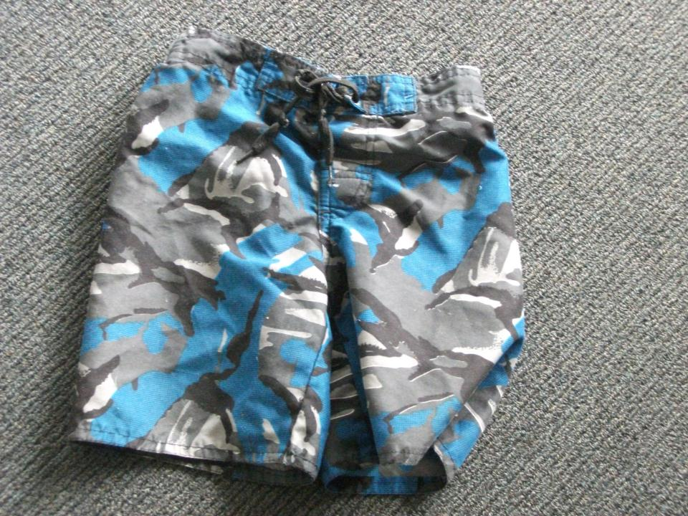
Here are my togs.

Slide 3
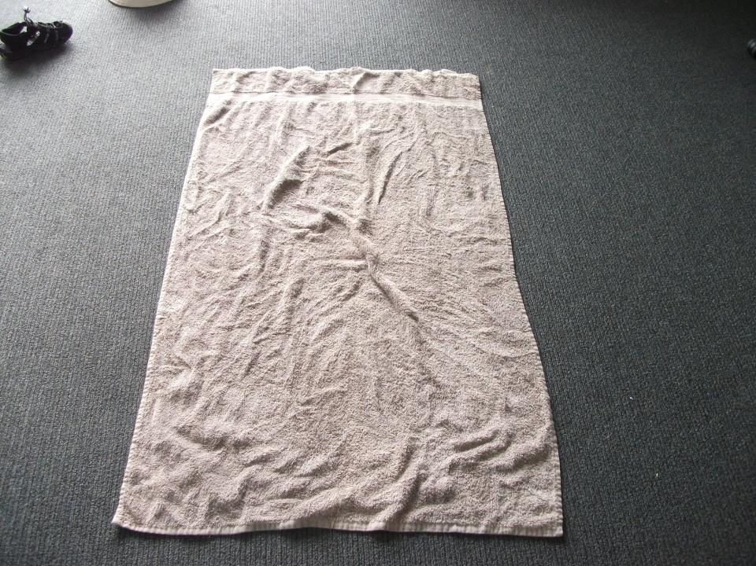
Here is my towel.

Slide 4
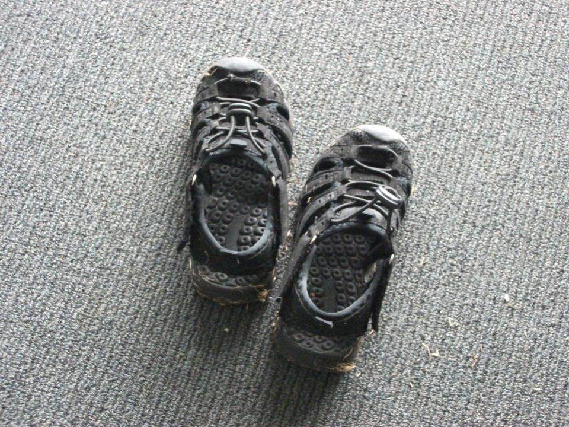
Here are my shoes.

Slide 5
Here is my hat.

Slide 6
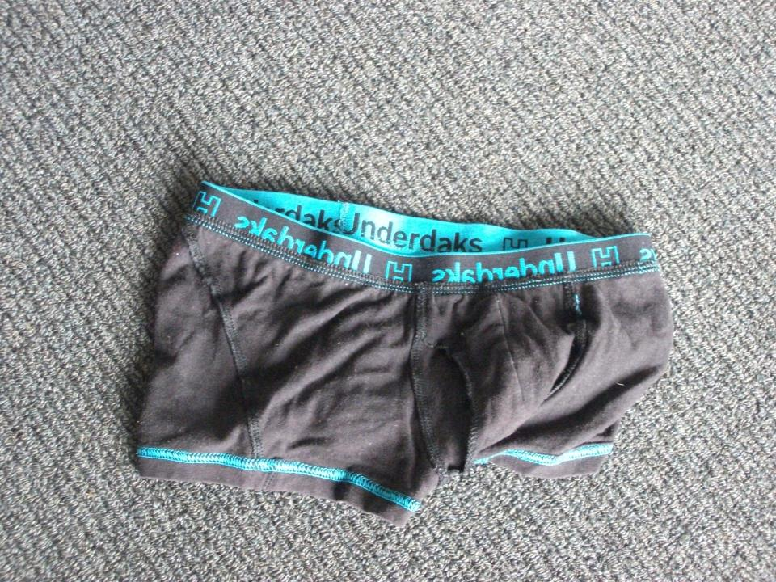
Here are my spare undies.

Slide 7
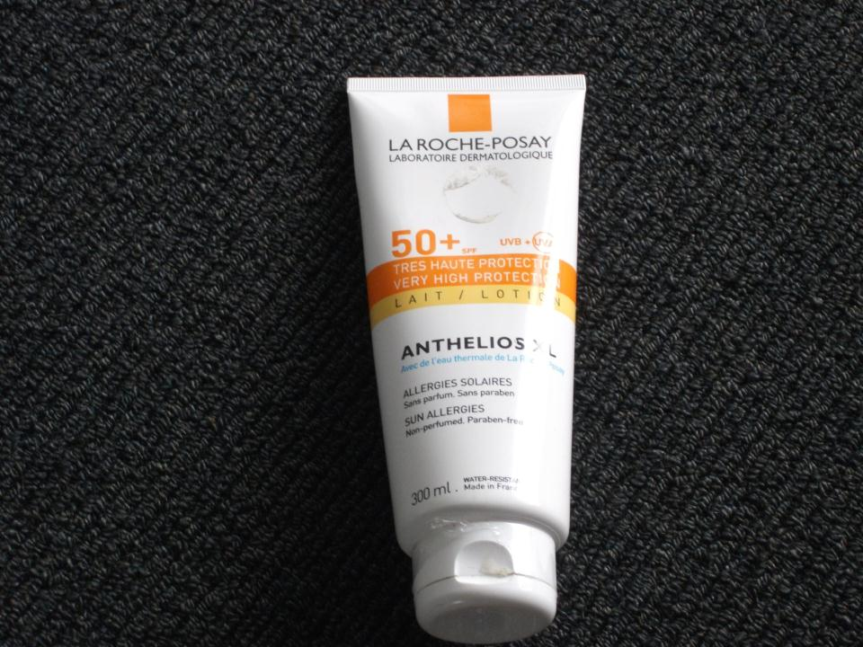
Here is my sunscreen.

Slide 8
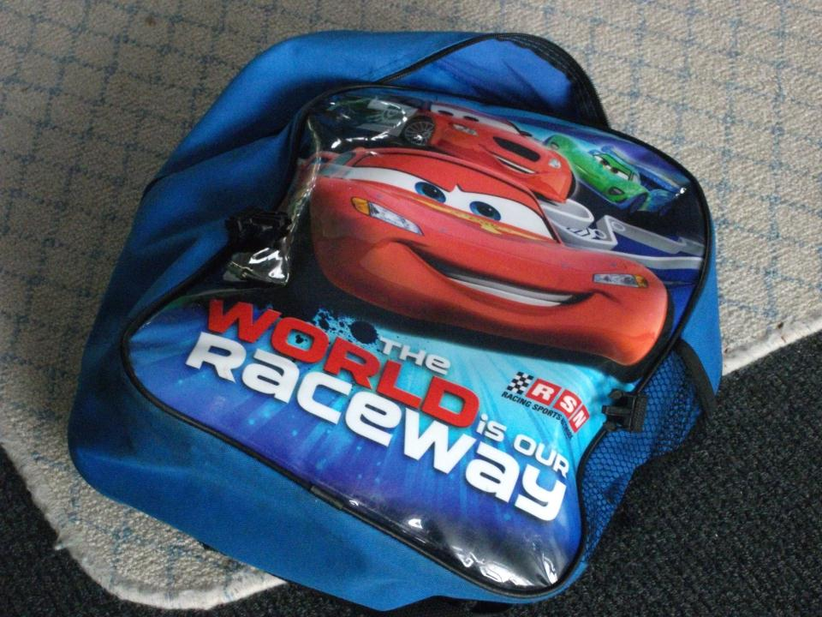
Here is my school bag.

Slide 9
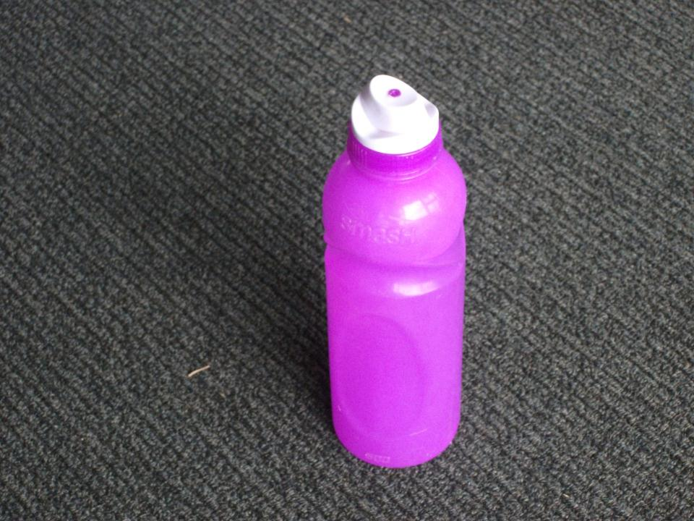
Here is my water bottle.

Slide 10
Here is my class.
Let’s go swimming.

